Slide 1

Project IRIS
An integrated oil refinery decarbonization project
Power & Gas Forum
Athens
March 28th/29th , 2024

Slide 2
A project that serves MOH’s main strategic directions
Increases resilience by drastically reducing refinery’s GHG emissions, both directly and indirectly
.. with significant benefits for the Country
Closer to the achievement of NCEP’s targets
Achieves REDIII industrial use of H2/ RFNBOs targets
Enhances the competitiveness of exports and safeguards energy security
Safeguards currently existing industrial jobs and creates new ones
Attracts significant EU funding (directly and through synergies)
Set the basis for the development of new markets as it actively introduces CO2 utilization
MOH becomes a major Blue Hydrogen producer while expanding the capacity to further decarbonize its operations
Provides for wider thermal integration of the refinery
Materializes CO₂ circularity via the production of e-Methanol
Reduces Scope 3 emissions through the introduction of low carbon methanol and hydrogen to end uses
Synergies with existing projects (Trieres Hydrogen valley)

Slide 3
Project’s perimeter

Slide 4
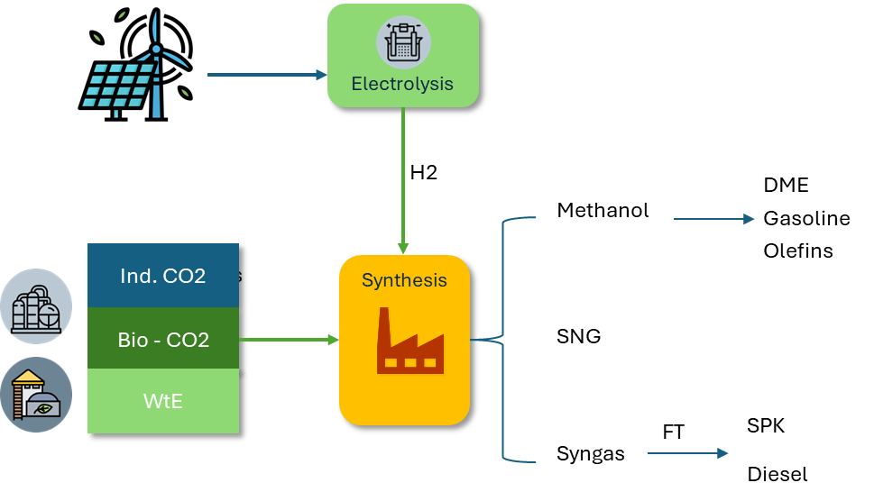
Carbon Utilization in IRIS: Methanol production
E-fuels: an option for the hard to abate sectors
Methanol is the precursor of high value chemicals and fuels
Current regulatory framework provides for the use of captured fossil CO2
On-site availability of green H2 is a major contributing factor
The methanol unit contributes to the opening of CO2 market
Operating in a demanding industrial complex in tandem with the capture unit
Allows for the testing of different business models, including sourcing of CO2 from 3rd parties
Circularity is served
Catalytic hydrogenation of CO2 is gaining momentum with new plants coming online

Slide 5
Challenges & Remedies
Challenges: As recognized in the Industrial Carbon Management Strategy Communication
Remedies: As expressed in the Aalborg’s CCUS Forum conclusions
…significant up-front investment capital required, uncertainty of future CO2 prices, storage capacity readiness..
…..EU and Member States to put in place more funding and de-risking mechanisms supporting business cases along the carbon management value chains….
…..pro-active storage exploration and deployment as the issue with the longest lead-time in the value chain…the Member States to step up their efforts to explore their CO2 storage potential
….. to continue the work on a fit-for-purpose EU regulatory framework for an EU wide multimodal CO2 transport network, based on transparent, fair, and non-discriminatory access conditions….
….. urgency to assess any potential gap in CO2 quality standards and where necessary to develop common standards….
….. the need to support and de-risk capture projects located away from industrial hubs….
…lack of a comprehensive regulatory framework across the value chain…coordination and planning…
…first movers involved in building carbon value chains also face CO2-specific cross-value chain risks, such as liability for leakages or the unavailability of transport and supporting infrastructure..(+ …lack of specifications…)
…insufficient incentives for private and public investment to proof the business case for industrial carbon management…
Notes:
Accelerating permitting and defining strategic net-zero projects: Requires the establishment of a “one stop shop” in each country to coordinate permitting of manufacturing projects, and sets detailed timelines for permitting procedures, with “strategic” projects given priority status.
Increasing CO2 injection capacity: Sets an EU-wide goal to achieve an annual CO2 injection capacity of 50 million tonnes (Mt) by 2030. Notably, oil and gas producers will be asked to contribute to the 50 Mt target, calculated pro-rata based on each entity’s share in the EU's crude oil and natural gas production.

Slide 6
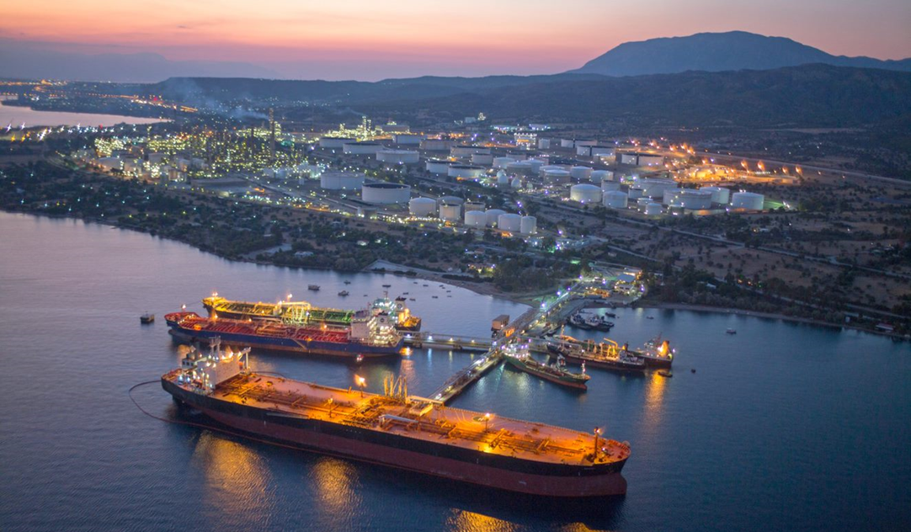
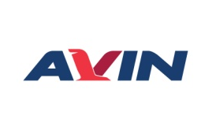




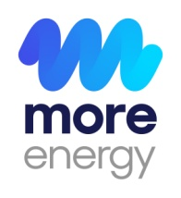
Thank you very much!

